Slide 1
STUDENT EMPLOYEE JOBX TRAINING

Slide 2
TRAINING AGENDA
Login to JobX
Online Help Available
Complete a JobMail Subscription
Find a Job
Apply for a Job
JobX ‘My Dashboard’ Feature
Selected for Hire Process
Employment Forms
Hired – Final approval
Questions?

Slide 3
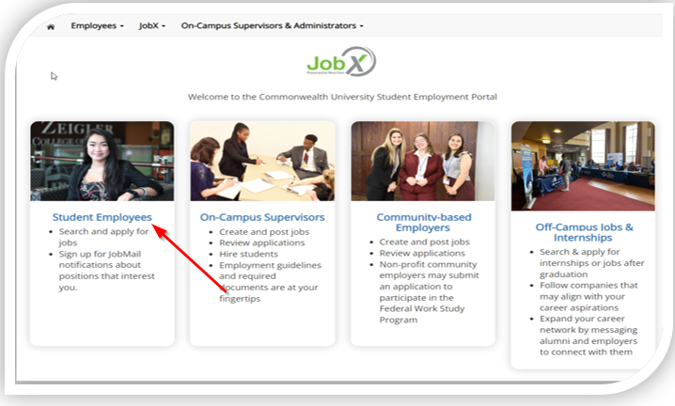
Login to JobX:
Navigate to your school’s customized JobX Site
Then Click on the ‘Student Employee’ link.

Slide 4
Step 1:
Click ‘Dashboard’ or ‘Manage JobMail’ link on the Applicants & Employees home page.

Slide 5
Step 2: Student Employee Login to JobX
Login utilizing your ‘SSO ID’ and ‘Password’

Slide 6
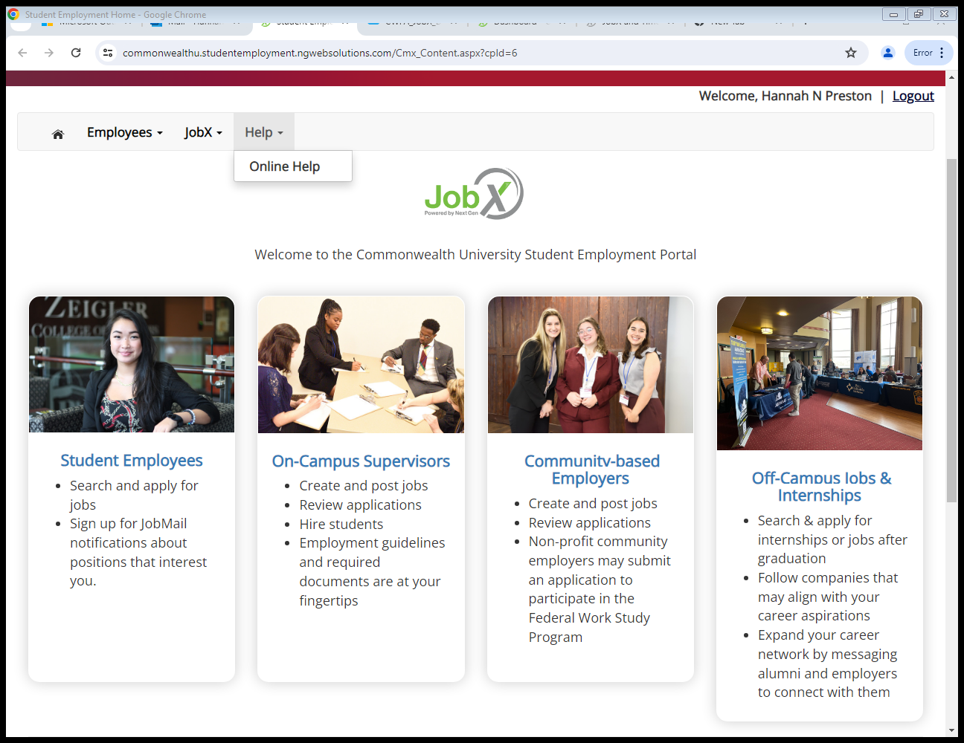
ONLINE HELP
Click the ‘Help’ menu after you login and select ‘Online Help’.

Slide 7
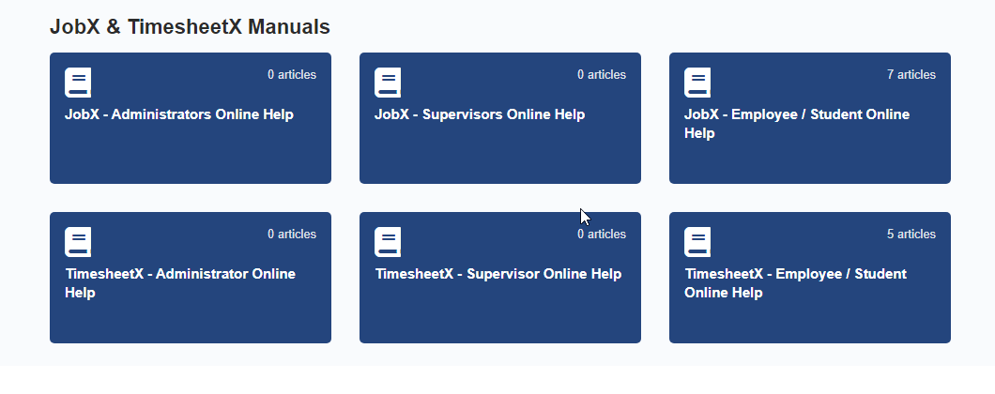
ONLINE HELP
Online guides are available based on your login role.
Employee/Students can only see Online Help for Employees/Students.
You have the ability to search by keyword or topics in the search field.

Slide 8
JOBMAIL- WHAT IS IT?
JobMail notifies you about potential job matches based on your interests.
Must complete a JobMail Subscription to receive notifications.
After JobMail setup you will receive notifications on new job listings that interest you.
The email will provide all details about the job to assist you in identifying a great job opportunity.

Slide 9
How to Access JobMail:
Step 1: Click ‘Dashboard’ or ‘Manage JobMail’ link in the Applicants & Employees home page.

Slide 10
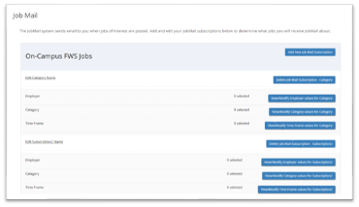
CONFIRGURE YOUR JOBMAIL SUBSCRIPTION
You may create multiple subscriptions and name them as desired for each Job Type (On-Campus FWS, On-Campus Scholarship Hours) supported by JobX
For Example: You can create a Summer Subscription that has different attributes than your Academic Year Subscription
For each subscription, you may set criteria
Desired Departments (JobX Employers) you wish to work (e.g. Biology & English)
Desired Job Categories you’re interested in (e.g. Tutoring, Clerical, etc.)
Desired Time Frames you’re interested in working (e.g. Summer Only, Academic Year, etc.)

Slide 11
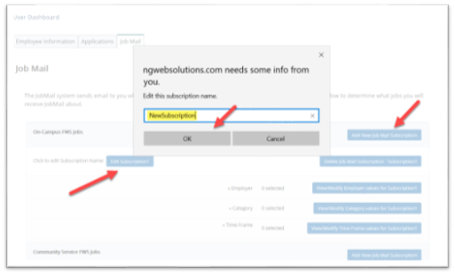
CONFIRGURE YOUR JOBMAIL SUBSCRIPTION
Click ‘Add New JobMail Subscription’ button to start the setup process to creating a JobMail subscription.
When the subscription name window pops up, update to your desired name.
If you need to edit the subcription name, click the ‘Edit Subscription’ button.

Slide 12
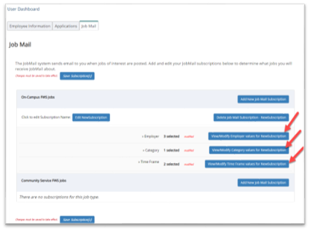
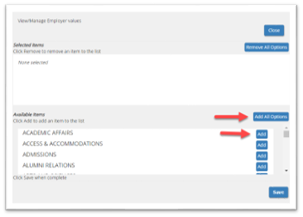
CONFIRGURE YOUR JOBMAIL SUBSCRIPTION
Click ‘Add all Options’ or ‘Add’ next to each item you wish to add to your JobMail subscription.

Slide 13
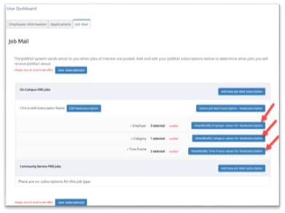
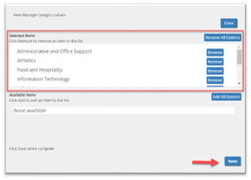
CONFIRGURE YOUR JOBMAIL SUBSCRIPTION
Your selection(s) will appear in the top under ‘Selected Items’.
When you’re finished adding search criteria, click ‘Save’.
Repeat this step for each Job Type and Criterion (Department/Employer, Category, and Time Frame).
You may return to this screen anytime to modify your subscription.

Slide 14
Find a Job…

Slide 15
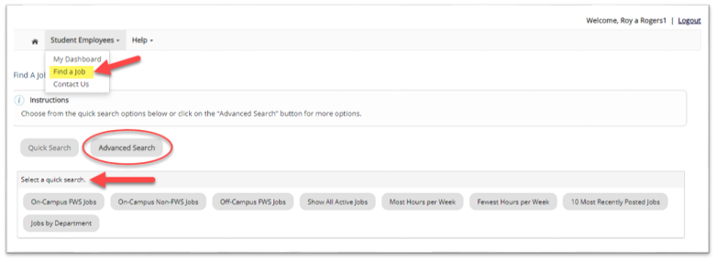
QUICK SEARCH
Click the ‘Find a Job’ function from the Employees Menu.
Select a specific pre-defined ‘Quick Search’ you would like to utilize to find a job.
Otherwise, to define your own custom job search filters click ‘Advanced Search’.

Slide 16
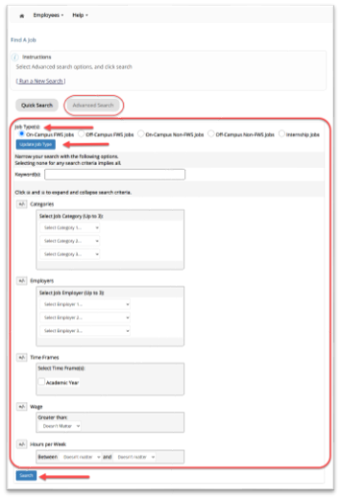
Advanced Search:
Click the ‘Advanced Search’ button to define your own job criteria you wish to search.
Advanced Search enables you to search for jobs by the following:
Search by Job Type Population (On-Campus FWS, Off-Campus FWS Jobs, etc.)
Keyword(s) Search
Job Category, Employers/Department, Time Frame, Wage, and hours per Week.

Slide 17
Apply for a Job…

Slide 18
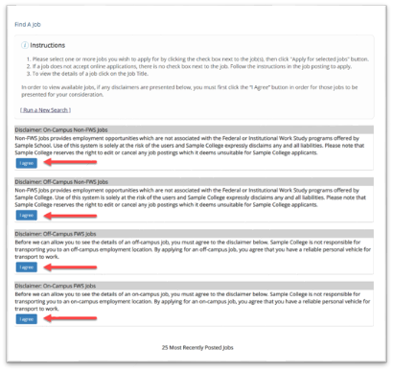
DISCLAIMER STATEMENTS:
In order to view available job listings, you may be required to review and agree to one or more disclaimer statements.
A disclaimer statement will be presented for all Job Types you selected.
After you’ve successfully reviewed the applicable disclaimer statement(s), you will be required to click the ‘I agree’ button(s) before any available jobs of that Job Type population will be presented.

Slide 19
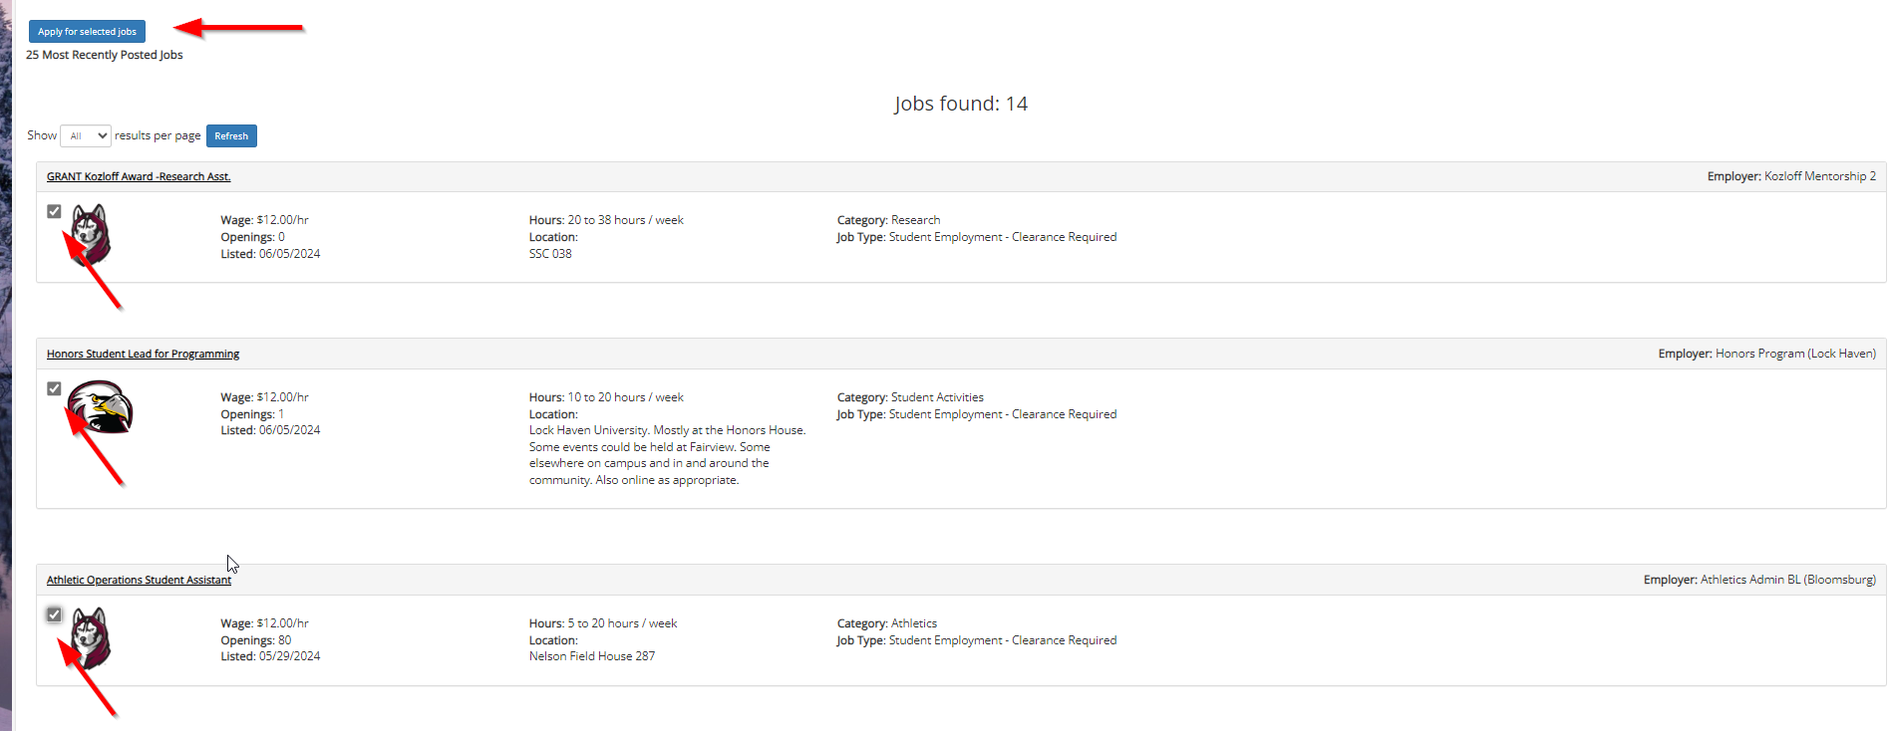
WITH ONE CLICK- APPLY FOR A JOB!
Click the box next to the jobs you wish to submit an application.
Then, click the ‘Apply for Selected Jobs’ button. You can apply to multiple positions at the same time!
Please Note: School logos are added for your convenience to help you apply for positions located on your home campus.

Slide 20
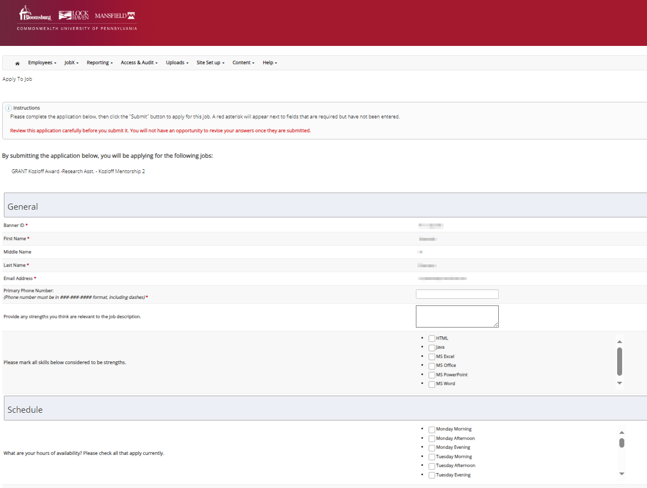
JOB APPLICATION:
Complete the questions on the application.
Fields with red asterisk are required to be completed before your application can be successfully completed.
Some of the fields may have information pre-filled. Please be sure to review and update the information as needed.
You may upload a resume for the hiring employer to review, if desired. In order to do so, browse to that file on your computer and click ‘Open’.

Slide 21
APPLICATION SUCCESSFULLY SUBMITTED:
Your application is successfully submitted when you received the Congratulations message.

Slide 22
My Dashboard…

Slide 23
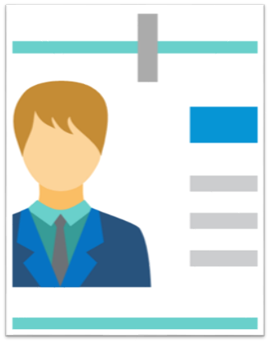
WHAT IS THE JOBX MY DASHBOARD FEATURE?
The JobX ‘My Dashboard’ feature provides a centralized location to access all your JobX data.
‘My Dashboard’ Includes:
Applications: Status, View, Print, Withdraw
Offers: Accept/Decline Job Offers
Hires: Past/ Current/ Future
JobMail Subscriptions

Slide 24
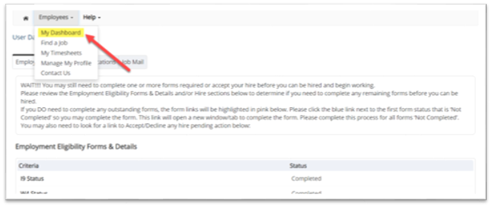
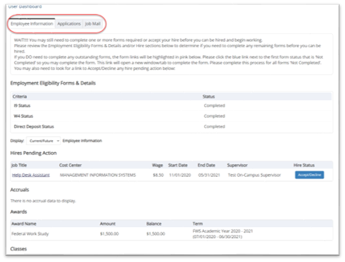
MY DASHBOARD: ACCESS
To access your ‘My Dashboard’ feature, click the ‘My Dashboard’ feature from the employees menu.
To access the past/current/future hires, applications, or JobMail subscription, click the respective tab you wish to view.

Slide 25
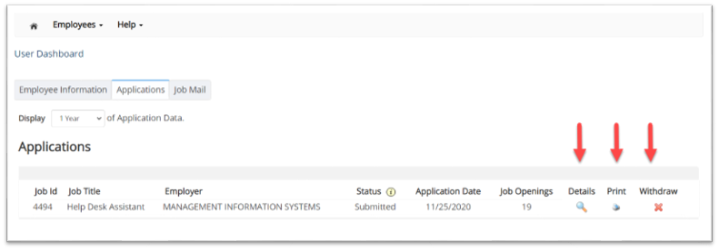
MY DASHBOARD: APPLICATION
My dashboard provides real-time self service access to past/ current/ pending hires.
You may customize your application view and print applications.
You may withdraw a previously submitted application by clicking the red ‘X’ next to the application if you are no longer interested in the job. (Please note: If the applicant has already been hired, there will be no red “X” displayed)
Applicants have two options when withdrawing their application.
Withdraw an application and email the supervisor to explain why you are withdrawing your application; OR
Withdraw and application without emailing the supervisor.

Slide 26
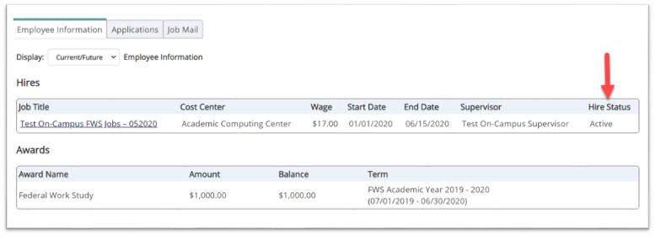
MY DASHBOARD: HIRES
My dashboard provides real-time self-service access to past/current/pending hires.
Click on the Employee Information Tab to see the status of your jobs.

Slide 27
Selected for Hire…

Slide 28
NEXT STEP: SELECTED FOR HIRE:
Upon being selected for hire by the supervisor, you will receive an email with instructions for the next steps. Please log in to JobX and navigate to your dashboard to complete all required employment forms. Any forms that require completion will be highlighted in pink and linked for your convenience.

Slide 29
EMPLOYMENT FORMS:
How does a student complete employment paperwork?

Slide 30
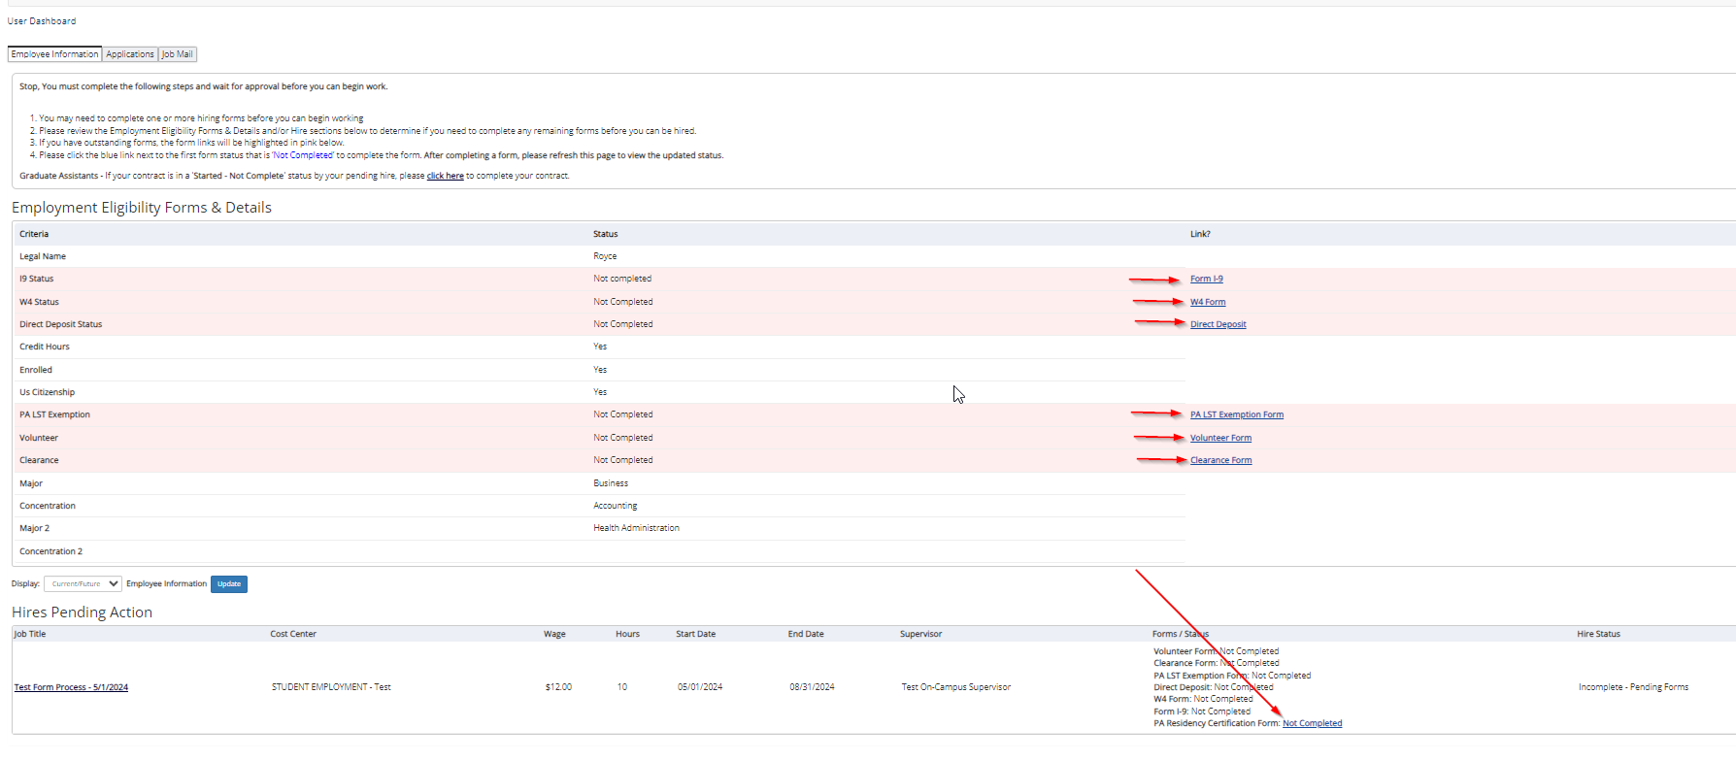
EMPLOLYMENT FORMS:
Before you are approved for hire, all employment forms will need to be completed and are displayed on ‘My Dashboard’. The incomplete forms will be highlighted in pink.
NOTE: The PA Residency Form is required for all hired students for each position you are hired for. If you hold multiple positions, you will need to complete this form for each hire in subsequent terms. You can find this form under the “hire” section.
To access your ‘My Dashboard’ feature, click the ‘My Dashboard’ feature from the Employees menu.
The following slides are examples of completing the I-9 Form.
Click ‘Form I-9’ link to start the Form I-9 process

Slide 31
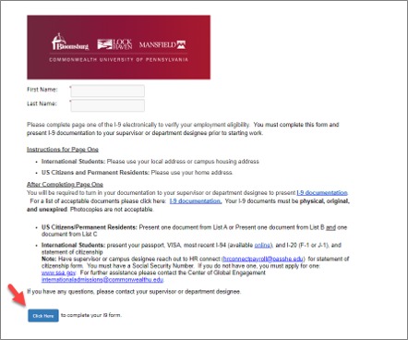
ELECTRONIC FORM I-9 WORKFLOW- EMPLOYEE
Your first and last name fields are populated from JobX. Please read the information on the cover page.
Then, select ‘Click Here’ to proceed to the Form I-9.
Students: Will complete section 1 of the form.
Supervisors: Complete section 2 of the Form I-9 once the student presents the employment documents for physical inspection.

Slide 32
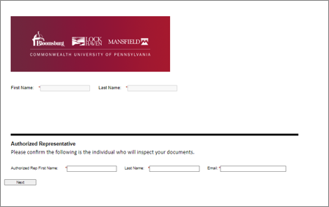
ELECTRONIC FORM I-9 WORKFLOW- EMPLOYEE
Verify that the person listed on the next page is the individual who will be reviewing your employment documents.

Slide 33
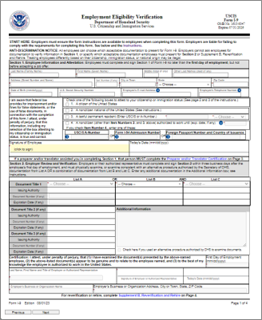
ELECTRONIC FORM SECTION 1- COMPLETED BY EMPLOYEE
Complete section 1 of the I-9 and electronically sign the form, including uploading your employment documents for record retention.
As a reminder, you will still need to present your original documents to the supervisor indicated in the previous screen for Physical Inspection of the employment documents before your Form I-9 is approved.
Next, click ‘Next’ to review the next page of the document until you receive a ‘Thank you for submitting your document page.’ Your document is not submitted until you review this page. Since this is a legal document, all pages must be presented to the individuals signing the document.

Slide 34
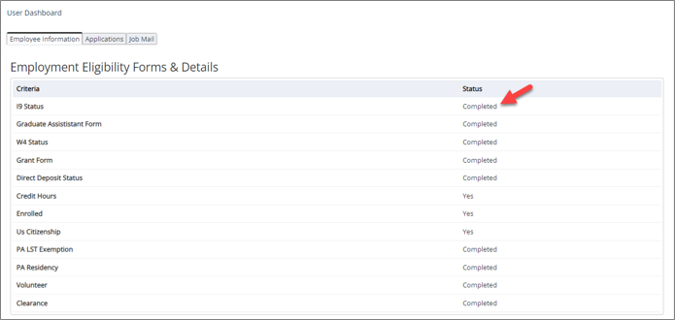
USER DASHBOARD UPDATED: WORKFLOW COMPLETED!
Once all the forms are approved, the ‘My Dashboard’ Form Statuses are updated to ‘Completed’.
Once you have completed all the required employment forms, your hire request will go to the Financial Aid office for awarding and then to Payroll for processing.
You are not authorized to begin employment until both offices have processed your hire request, and you have received a confirmation email from payroll granting permission to start work.

Slide 35
Hired…

Slide 36
FINAL APPROVAL
PLEASE NOTE: Students will not be approved to work until they received a Hire Approval e-mail stating that they may begin work.
Example of email below:

Slide 37
Questions?
Please contact :
Christina Preston
CU Student Employment Coordinator
workstudy@commonwealthu.edu

